Slide 1
ANALYSIS
MENU
ANALYSIS
CONTACT
Data ANALYSIS
DATA
Crime Prediction

Slide 2
TABLE OF CONTENT
Problem Definition:
Dataset utilized:
01
02
Preparations and preprocessing:
Methods employed:
03
04
MENU
ANALYSIS
CONTACT
Data ANALYSIS

Slide 3
01
Problem Definition:
MENU
ANALYSIS
CONTACT
Data ANALYSIS
Predicting Crime Rates Using Data Analysis

Slide 4
Objective:
Challenges:
Approach:
MENU
ANALYSIS
CONTACT
Data ANALYSIS
To develop a predictive model that accurately
forecasts crime rates in specific areas, using historical crime data and various predictive analytics techniques.
To identify patterns and trends in criminal activity, which can inform proactive crime prevention strategies.
Dealing with large, complex datasets that may contain incomplete or inconsistent records.
Ensuring the predictive model is sensitive to the dynamic nature of crime and demographic changes.
Incorporating various features such as location coordinates, time of incidents, and types of crime for a comprehensive analysis.
Using machine learning algorithms (like linear regression) and data visualization techniques to analyze crime patterns.

Slide 5
Dataset utilized:
Features:
Information
MENU
ANALYSIS
CONTACT
Data ANALYSIS
objectid: Unique identifier for each record
dc_dist: Police district code
psa: Police Service Area
dispatch_date_time: The exact date and time when the crime was reported
dispatch_date: The date when the crime was reported
dispatch_time: The time when the crime was reported
hour: The hour of the day when the crime was reported
dc_key: The District Control Number (unique identifier for crime incidents)
location_block: The block where the crime occurred
ucr_general: The Uniform Crime Reporting code that categorizes the crime
text_general_code: Text description of the crime
point_x: Longitude coordinate
point_y: Latitude coordinate
lat: Latitude
lng: Longitude
Source: Kaggle
Geographical Focus: Philadelphia
Time Frame: 2018 – 2023
Volume: 639742

Slide 6
Preparations and Preprocessing
Installation of Required Libraries:
Data Cleaning:
Data Loading:
MENU
ANALYSIS
CONTACT
Data ANALYSIS
The code begins with installing necessary Python libraries that are essential for data manipulation, visualization, and modeling.
This includes plotly, pandas, geopandas, folium, seaborn, matplotlib, and machine learning libraries from sklearn.
The objectid column, which serves as a unique identifier, is retained for reference.
Duplicate records are identified and removed to ensure the uniqueness of each crime event.
Missing values are checked across all columns. The na_counts variable suggests that rows with missing point_x (longitude) and point_y (latitude) were dropped since they are crucial for geospatial analysis.
The dtypes check is performed to ensure that each column is of the correct data type for analysis.
The dataset is loaded into a pandas DataFrame, which allows for easy manipulation and analysis.

Slide 7
Preparations and Preprocessing
Feature Engineering:
Data Transformation:
Data Visualization:
MENU
ANALYSIS
CONTACT
Data ANALYSIS
Unnecessary features, such as dispatch_date_time, are dropped to simplify the dataset.
New temporal features are created, such as year, month, and hour, extracted from dispatch_date and dispatch_time to facilitate time-series analysis.
The location_block is kept as-is for potential geospatial mapping.
The dispatch_date and dispatch_time columns are converted to datetime objects to enable time-series analysis.
The standardize_crime function is applied to the text_general_code to categorize crimes into broader groups like 'Violent', 'Property', and 'Other’.
Columns are renamed for consistency and clarity, for instance, removing any leading or trailing spaces from column names.
Several plots are created to visualize crime trends over time, including bar charts for crimes per year, crimes by month in 2019, and a heatmap of crime intensity across different districts.
The Basemap library is used for creating a heatmap to visualize crime density in different parts of the city.

Slide 8

METHODS
MENU
ANALYSIS
CONTACT
Data ANALYSIS
Geospatial Analysis:
Geographical coordinates are used to plot the locations of crimes on a map. The folium library is employed to create interactive maps that can display crime hotspots with heatmaps and markers.
Temporal Analysis:
The dataset is analyzed to find temporal trends, such as the frequency of crimes by hour, month, and year. This helps in understanding how crime rates vary over time.
Predictive Modeling:
A linear regression model is used as the predictive method.
This model is aimed at understanding the relationship between the time of crime incidents and other features like the police district and geographical coordinates.
Model Training and Testing:
The dataset is split into training and testing sets to evaluate the model's performance.
The SimpleImputer from sklearn is used to handle missing values by filling them with the mean of the respective column.

Slide 9
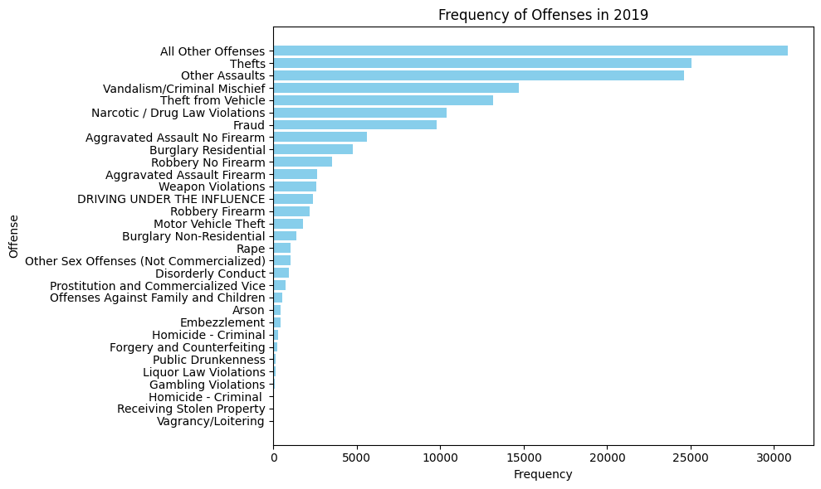
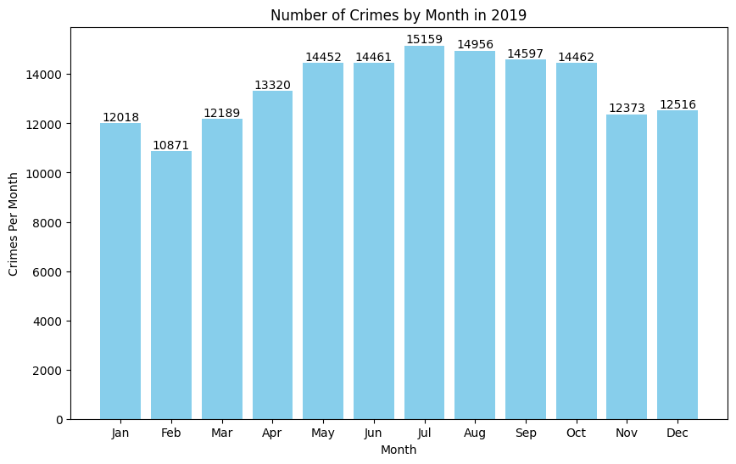
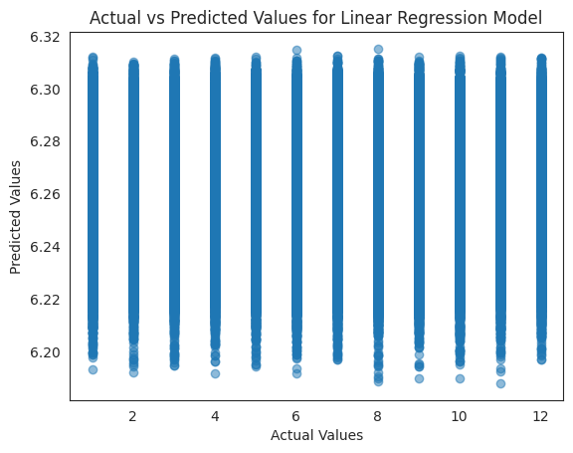
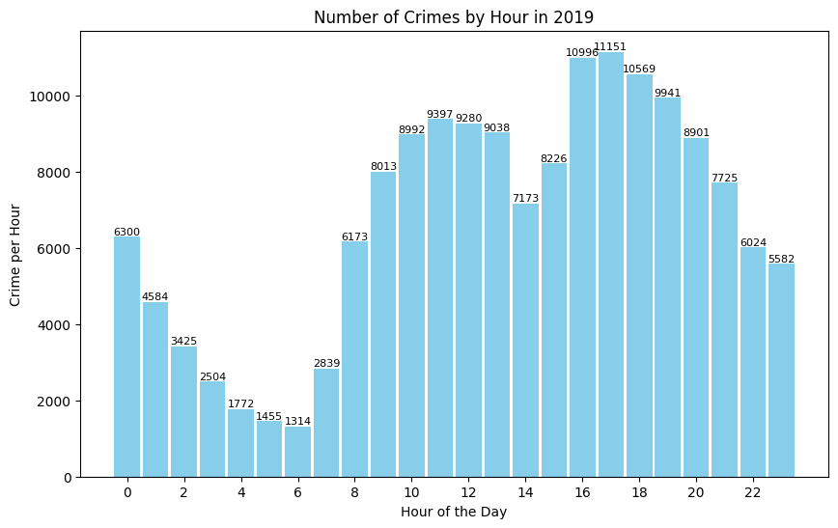
Results
MENU
ANALYSIS
CONTACT
Data ANALYSIS
Model Performance:
The linear regression model resulted in a Mean Squared Error (MSE) of 11.858422232363381.
Temporal Trends:
The analysis of crimes by hour in 2019 indicated that certain times of the day had higher crime rates, notably in the late afternoon and evening hours.
Monthly crime data for 2019 showed that crime rates were relatively consistent throughout the year, with slight variations.
Crime Types and Frequencies:
The frequency of offenses in 2019 highlighted that 'All Other Offenses', 'Thefts', and 'Other Assaults' were the most commonly reported crimes.
Prediction Accuracy:
The scatter plot of actual vs. predicted values from the model suggests there are distinct groupings.

Slide 10
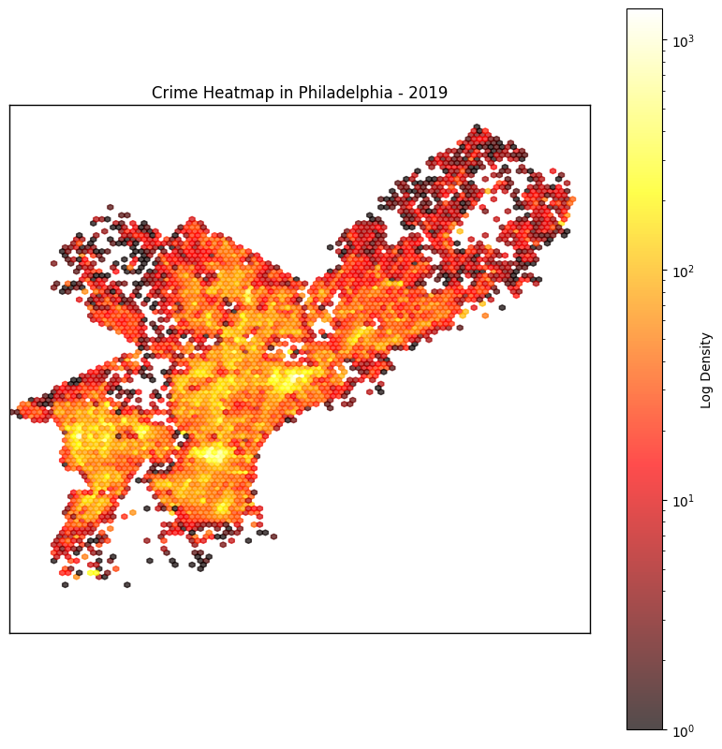
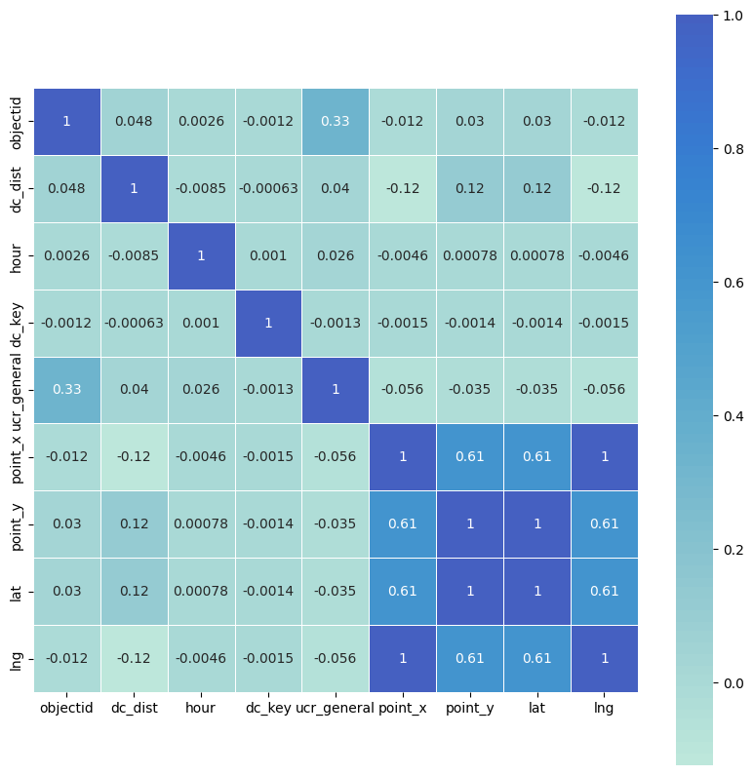
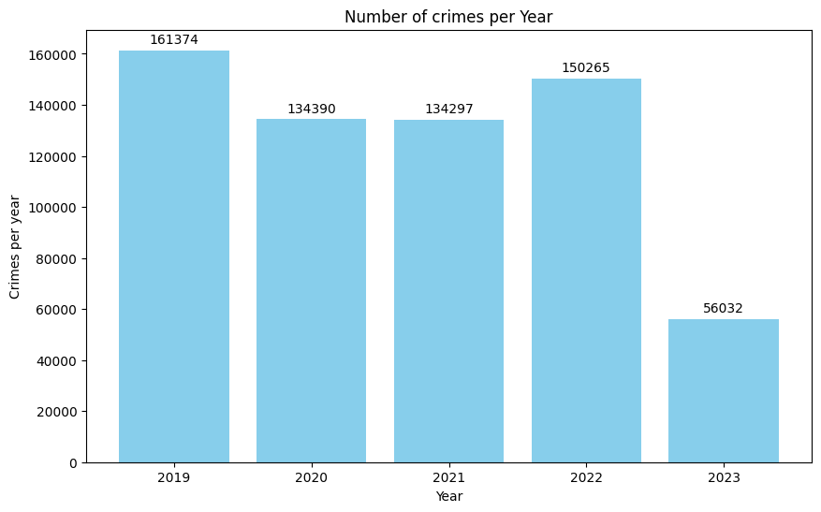
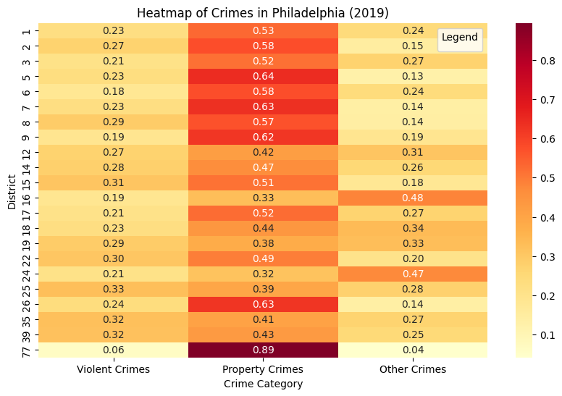
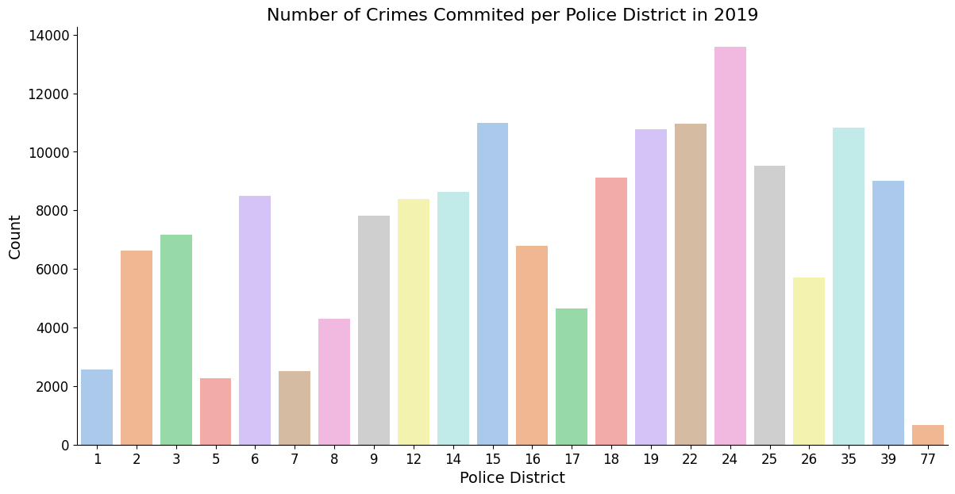
MENU
ANALYSIS
CONTACT

Slide 11
THANKS!
MENU
ANALYSIS
CONTACT
Data ANALYSIS
Do you have any questions?

